Slide 1


PRESENTED TO
KULTUREHIRE
Genz analysis
There’s a widening gap between GenZ employees and employers in terms of work style and expectations. To build workplaces that resonate with younger professionals, it’s essential to uncover what GenZ truly values in an employer.
01
WWW.REALLYGREATSITE.COM
PRESENTED BY
MOHAMED JAKKRIYA

Slide 2

Benefits of
Data Analysis
GenZ career aspirations analysis powered by KultureHire offers deep strategic value. It uncovers key career motivators such as impact, flexibility, and purpose, helping employers craft more attractive roles. By decoding learning preferences—like self-paced or manager-led—you can shape tailored development programs. The data also highlights GenZ’s preferred team size and work setup, enabling better workspace design and collaboration models. Insights into managerial influence and frustration points drive improvements in leadership styles and organizational culture. Salary expectations and remote work attitudes offer valuable benchmarks for HR policy updates. This analysis also reveals whether GenZ is mission-driven and how they respond to company values. Retention indicators like “Stay 3+ or 7+ years” give early signals for long-term planning. Overall, it positions KultureHire as a thought leader in workforce intelligence while helping businesses future-proof their talent strategies.
02
WWW.REALLYGREATSITE.COM

Slide 3


Data Collection
Methods
We utilized Google Sheets for structured surveys.
Interviews complemented the surveys for deeper insights.
This hybrid method balanced scale and personal depth.
Questions covered career goals, salaries, work setup, and learning styles. offered quantifiable trends across GenZ demographics.
The format ensured clear, reliable responses.
Rather than interviews, we captured detailed insights via open-text survey questions.Respondents shared motivations, frustrations, and expectations in their own words.This added qualitative depth to the structured survey data.
To decode GenZ’s career mindset using both numbers and narratives.Help employers align strategies with modern workforce expectations.Build a scalable framework for future talent insights.
03
WWW.REALLYGREATSITE.COM

Slide 4

Tools for
Data Analysis
Spreadsheets
SQL(MYSQL)
Power BI
Used for pivot analysis, cleaning, and exploratory data visualization. Also powered the executive dashboard with KPIs and slicers.
Ran queries to extract patterns from cleaned survey responses. Helped validate trends and answer business questions with precision.
Delivered functional dashboards for HR and Recruitment insights. Included slicers and KPIs tailored to different stakeholder needs
04
WWW.REALLYGREATSITE.COM

Slide 5
Understanding the problem
Career aspirations-5w1h
WHO
WHAT
WHEN
GenZ individuals (born 1997–2012), especially from poor and middle-class backgrounds facing financial and social mobility challenges
A growing mismatch between GenZ’s career goals (purpose, flexibility, growth, mental well- being) and what most employers currently offer
In the evolving post-pandemic job market shaped by digital transformation, economic shifts, and career uncertainty
WHERE
WHY
HOW
Urban and rural areas across India (and beyond), with disparities in opportunity access, remote options, and local hiring trends
Due to economic pressure, lack of mentorship, skills gaps, and a strong desire for work that feels meaningful and flexible.
Through structured surveys using Google Sheets and data analysis using Excel, SQL, and Power BI—revealing patterns in GenZ preferences
05
WWW.REALLYGREATSITE.COM

Slide 6
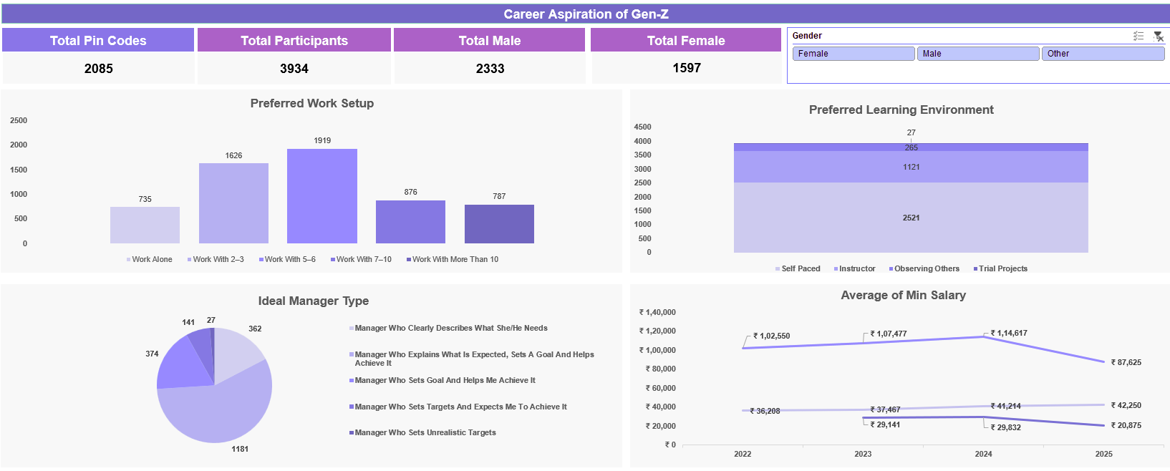
Genz aspiration -
Excel overview
INSIGHTS
👥 Small team culture rules—5–6 people per group is Gen Z’s sweet spot (1.9K responses).
🧪 Trial projects (2.5K) far outweigh other learning methods, signaling strong hands-on learning demand.
👀 Observation beats traditional instruction, while self-paced learning trails at the bottom.
🎯 Gen Z wants mentors, not managers—“Set goal & help achieve it” ranks highest in leadership preference.
🚫 Unrealistic expectations are widely rejected—only 27 choose this style.
💰 Salaries continue a steady rise from ₹36K (3yr) & ₹1.02L (5yr) in 2022 to ₹42K & ₹1.14L in 2025.
📍 Respondents span 2,085 PIN codes with 3.9K+ participants—gender split slightly favors males (2.3K vs. 1.6K).
💡 This data reveals Gen Z’s desire for clarity, mentorship, collaboration, and realistic growth in the workplace.
WWW.REALLYGREATSITE.C
06

Slide 7
DESCRIPTIVE analysis
Work Preference
A total of 1919 respondents prefer working in small teams of 5–6 members. Another 1626 prefer even smaller teams of 2–3 people. Only 735 respondents chose to work individually. Even fewer opted for larger teams (7+ members).This shows a strong GenZ tilt toward close, collaborative settings. Preference for smaller teams dominates across the entire survey group.
Learning Preference
A total of 64% of GenZ respondents prefer learning through trial projects. Only a small percentage favored traditional instructor-led training. Self-paced learning also ranked higher than classroom-based models. This shows a strong shift toward hands-on, experiential learning styles. GenZ values real-world application over passive content consumption. The data emphasizes their drive for practical, flexible learning environments
07

Slide 8
DESCRIPTIVE analysis
Ideal manager type
A large portion of GenZ respondents prefer supportive managers who offer clarity and feedback. Few respondents gravitate toward strictly authoritative or hands-off leadership styles. Managers with goal-setting and coaching qualities were ranked highest. Clarity in expectations was valued more than micromanagement. Empathy and accessibility were favored leadership traits. The trend reflects a strong preference for mentorship-style management.
Salary expectations
Survey data shows a peak in expected salary in 2024, followed by a slight dip in 2025. Most respondents expressed expectations around industry-average CTC levels. There’s noticeable variation across roles, with tech and analytics demands showing higher numbers. Expectations appear influenced by awareness, region, and job exposure. Entry-level candidates from urban regions reported slightly higher aspirations. Overall, GenZ remains realistic but growth-oriented in salary expectations.
08

Slide 9
GENZ CAREER ASPIRATION
sqL ANALYSIS
CAREER ASPIRATIONS
INFLUENCING FACTOR
SELECT Career_aspirations, COUNT(*) AS countFROM gen_zGROUP BY Career_aspirationsORDER BY count DESC;
SELECT Career_influencing_factors, COUNT(*) AS count
FROM gen_z
GROUP BY Career_influencing_factors
ORDER BY count DESC;
Content Creation, Tech, and Business dominate GenZ’s dreams—signaling a shift to autonomy and digital innovation.
Work-life balance and passion outweigh parental or peer influence—GenZ makes independent, purpose-led decisions.
WORK ENVIRONMENT
SALARY INFLUENCE
SELECT Preferred_work_environment, COUNT(*) AS countFROM gen_zGROUP BY Preferred_work_environmentORDER BY count DESC;
SELECT Career_aspirations, AVG(Expected_salary) AS average_salaryFROM gen_zGROUP BY Career_aspirationsORDER BY average_salary DESC;
09
WWW.REALLYGREATSITE.COM
Tech and Entrepreneurship rank highest in salary expectations—GenZ links value with reward.
Hybrid and Remote are clear winners—flexibility is no longer optional, it’s an expectation.

Slide 10
POWER bI
ANALYSIS
MANAGER ASPIRATIONS
MISSION ASPIRATIONS
DESCRIPTIVE ANALYSIS
DESCRIPTIVE ANALYSIS
The Manager Aspirations Dashboard is designed to provide recruiters, HR leaders, and employers with a clear understanding of what GenZ expects from their managers in a professional setting. It highlights the leadership traits that resonate most with young professionals—such as empathetic communication, regular feedback, clarity in goal-setting, and mentorship over authority. By analyzing preferences for management style across demographic segments, this dashboard enables organizations to tailor leadership development programs that better align with GenZ’s expectations, ultimately improving engagement, retention, and workplace satisfaction.
The Mission Aspirations Dashboard focuses on the deeper motivations that drive GenZ's career decisions, particularly around purpose, values, and social impact. It reveals how strongly this generation connects personal values to professional roles, with many prioritizing careers that contribute to sustainability, healthcare, education, or ethical innovation. This dashboard helps employers understand the rising importance of purpose-driven work and encourages them to align internal branding and roles with GenZ’s demand for meaningful contribution. It’s a valuable tool for shaping employee value propositions and communicating a strong, values-aligned mission in recruitment efforts.
Let me know if you'd like a slide-friendly version or visualization structure for these next!
WWW.REALLYGREATSITE.COM
10

Slide 11
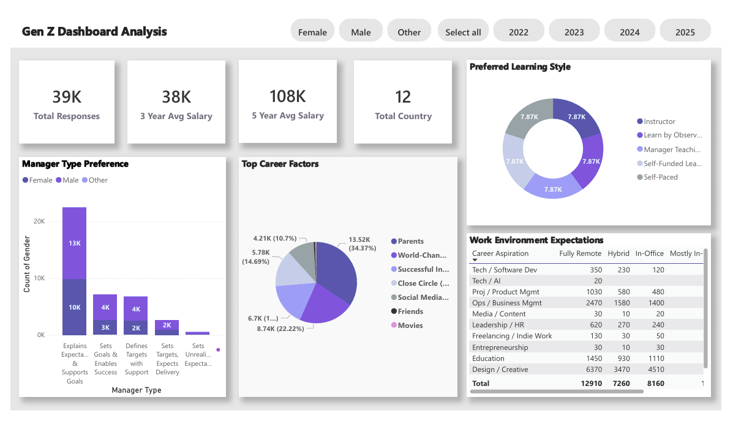
MANAGER ANALYSIS
- POWER bi
INSIGHTS
👩‍💼 Most Gen Zs—especially women—prefer managers who clearly set expectations and support their goals.
🧭 Parents are the strongest influencers on career choices (34%), followed by close circles and friends.
🎯 “World-changing impact” influences over 4K Gen Z respondents—strong sign of purpose-driven aspirations.
📚 Learning styles are evenly split—Gen Zs value self-paced, manager-led, instructor-led, and peer observation equally.
🏠 Design/Creative roles dominate remote work preference—6.3K favor fully remote environments.
🏢 Ops/Business Mgmt shows substantial interest in hybrid and in-office work setups (totaling ~5.5K).
🌍 The data reflects inputs from 12 countries, 39K respondents, with average salaries growing over 3 to 5 years.
WWW.REALLYGREATSITE.C
11

Slide 12
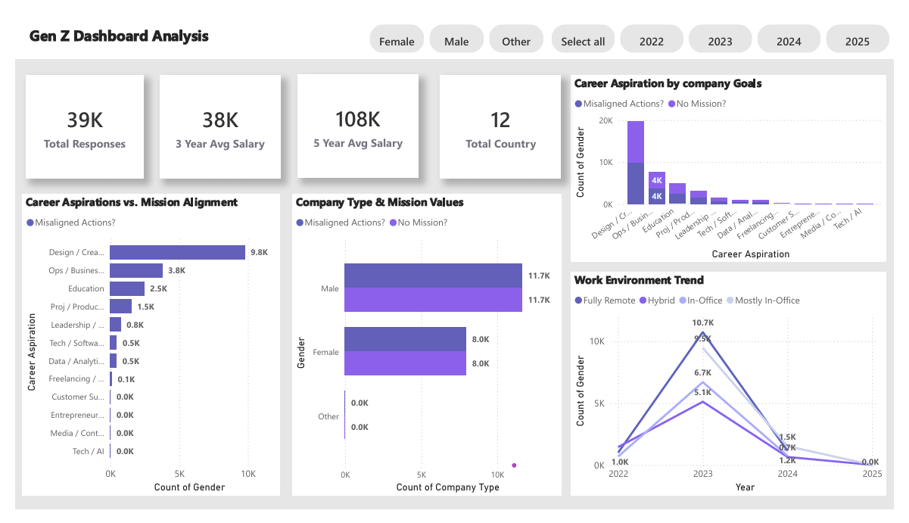
MISSION ASPIRATION
- POWER bi
INSIGHTS
🧠 Design/Creative roles top the chart for misalignment with company missions (9.8K cases).
🎯 Both male and female respondents show equal levels of mission misalignment—11.7K each.
🎨 Design/Creative also leads in gender-based aspiration gaps, followed by Education (4K).
🌐 Hybrid work peaked in 2023 (10.7K) but declined sharply in 2024 and 2025.
📊 Total responses: 39K; Avg salary: ₹38K (3-yr), ₹108K (5-yr); across 12 countries.
🚨 High misalignment highlights a growing disconnect between Gen Z aspirations and company values.
🌱 No-mission organizations attract significant attention but may miss deeper engagement.
💡 Organizations must align mission, culture, and hybrid flexibility to attract Gen Z talent.
WWW.REALLYGREATSITE.C
12

Slide 13

thank
you!
DATA ANALYSIS IS KEY TO BUSINESS GROWTH AND SUCCESS!
13
WWW.REALLYGREATSITE.COM
PRESENTED BY
MOHAMED JAKKRIYA

